Slide 1
Room photo detail (hyperlink)
<a class="fancybox" href="kingbedroom.jpg" data-fancybox-group="gallery" title="kingbed room">
<img src="kingbedroom.png" width="110" height="80" alt="" /></a>
<a class="fancybox" href="kingbedroom1.jpg" data-fancybox-group="gallery" title="kingbed room"></a>
<div class="p"> <input name="type" type="radio" value="single" onclick="ajaxFunction(12)"/> Lanai

Slide 2
FancyBox
FancyBox is a tool for displaying images, html content and multi-media in a Mac-style "lightbox" that floats overtop of web page. It was built using the jQuery library. Licensed under both MIT and GPL licenses

Slide 3
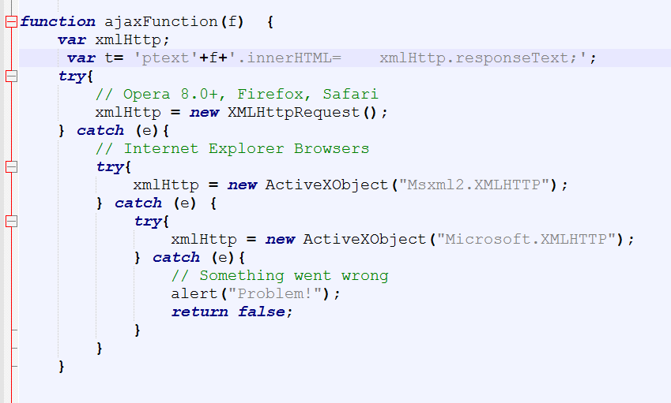
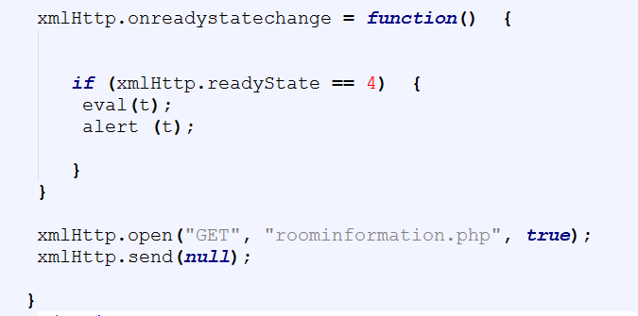
Remain room

Slide 4
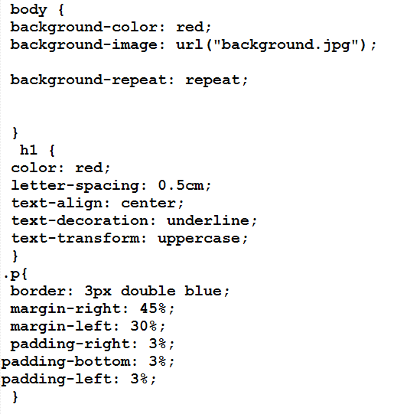
Margin and padding setting

